Slide 1













QUANTIFYING THE AIR TRAVEL EXPERIENCE: A COMPREHENSIVE ANALYSIS OF INFLUENTIAL FACTORS IN PASSENGER SATISFACTION
GROUP 05
MUHAMMAD ZAHRIEL BIN ISMAIL
HAN XIANG
IZZUL ILHAM BIN YUSOF
TASSLIM BIN MANSOOR ALI
ZHANG LEPING
Leader
Maker
Detective
Oracle
Presenter
22085509
22093085
22107573
23056322
22098083

Slide 2

CHAPTERS
Introduction
Problem Statement/Objectives
Data Science Pipeline
Exploratory Data Analysis
Conclusion

Slide 3
01
INTRODUCTION
Context of the project and highlighting the importance of understanding the Aviation industry and customer satisfaction

Slide 4

AVIATION INDUSTRY
One of the largest drivers of Tourism
Contributes to 7.6% of Global Tourism GDP
(WTC 2023)
Very Competitive field (Not about the destination but about the journey)

Slide 5

IMPORTANCE OF UNDERSTANDING CUSTOMER SATISFACTION
Customer retention
Service Improvements
Service Weightage (Resource Efficiency)

Slide 6
02 PROBLEM STATEMENT
The global aviation industry is fiercely competitive, emphasizing the pivotal role of passenger satisfaction in determining airline performance.
Passenger satisfaction is crucial for customer retention and gaining a competitive edge in the industry.
Question:-
What are the primary contributors that impact passengers' overall flying experience?
How do flight delays and arrival delays influence overall passenger satisfaction?

Slide 7

PROBLEM OBJECTIVE
To identify and analyse the key contributing factors that impact the overall customer experience in the context of airline travel.
To investigate the specific impacts of departure and arrival delays on overall customer experience.
To predict customer satisfaction using machine learning models.

Slide 8
SCOPE & DOMAIN
SCOPE:
RESEARCH DOMAIN:
The project encompasses various customer experiences, including
Check-in services
Online boarding
On-board service
Cleanliness
Food and beverages
Pre and post-flight services
Focused on customer airline satisfaction with a substantial sample size
(N > 120,000).
Emphasis on data obtained from customer feedback, with a specific focus on aspects such as Age and Gender.

Slide 9
LITERATURE REVIEW
JIANG, X., ZHANG, Y., LI, Y., & ZHANG, B. (2022) | Presents a study on the factors affecting airline passenger satisfaction using a RF-RFE-LR model to extract important variables affecting passenger satisfaction.
KUMAR, S., & ZYMBLER, M. (2019) | Focuses on analyzing customer satisfaction from airline tweets using machine learning. The paper explores numerous approaches to sentiment analysis, including document-level, phrase-level, and entity-level sentiment analysis.
NOVIANTORO, T., & HUANG, J. (2022) | The research highlights on the significance of providing excellent services to travellers to maintain a competitive edge within the airline industry. According to their findings, deep learning is the best machine learning model to predict airline passenger satisfaction.

Slide 10
03
DATA SCIENCE PIPELINE
Data Structure, Metadata and Data Quality assessment

Slide 11
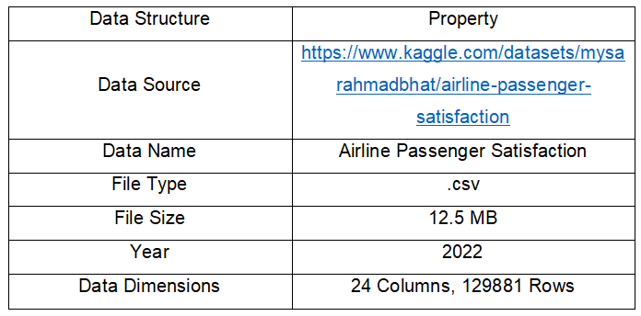
DATA STRUCTURE
Understanding the overall structure of the data is important before further analysis

Slide 12
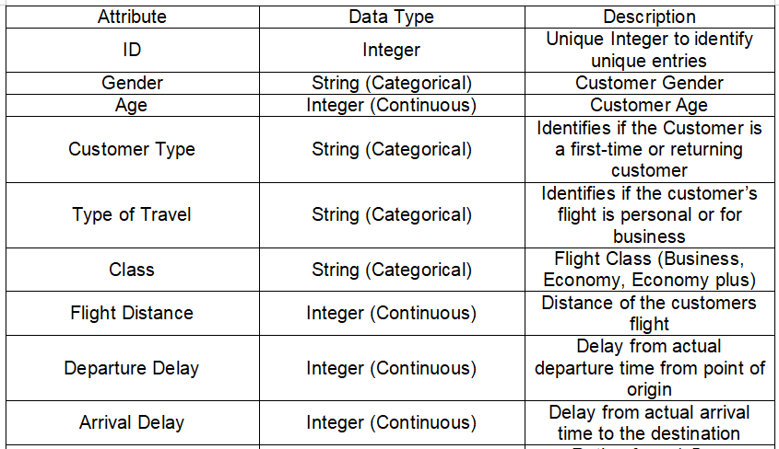
METADATA
Overall, structure of internal data
Noteable Columns:
Age
Flight Distance
Departure Delay
Arrival Delay

Slide 13
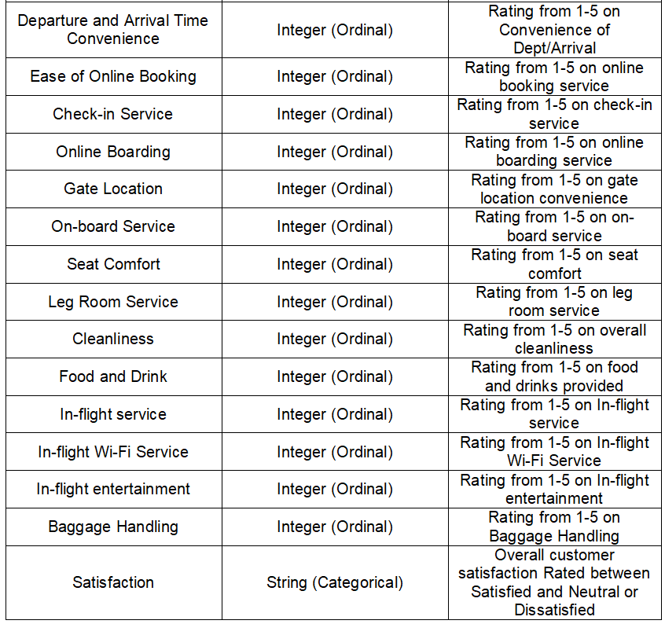
METADATA
Columns here are all ordinal columns rating from 1-5 stars
Target Column: Satisfaction

Slide 14
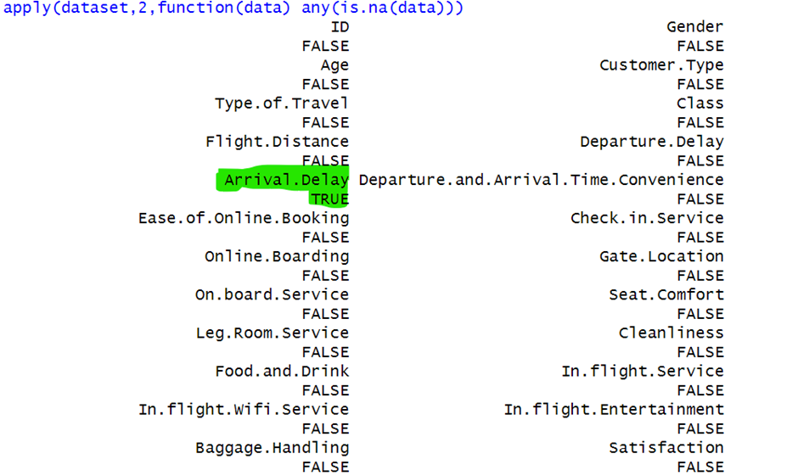
DATA QUALITY ASSESSMENT (PART 1)
Missing data
One feature with missing data, analysis shows that it effects 393 Rows
(N < 0.302% of total data)
Used Multiple Imputation by Chained equation(MICE) to impute the missing data.

Slide 15
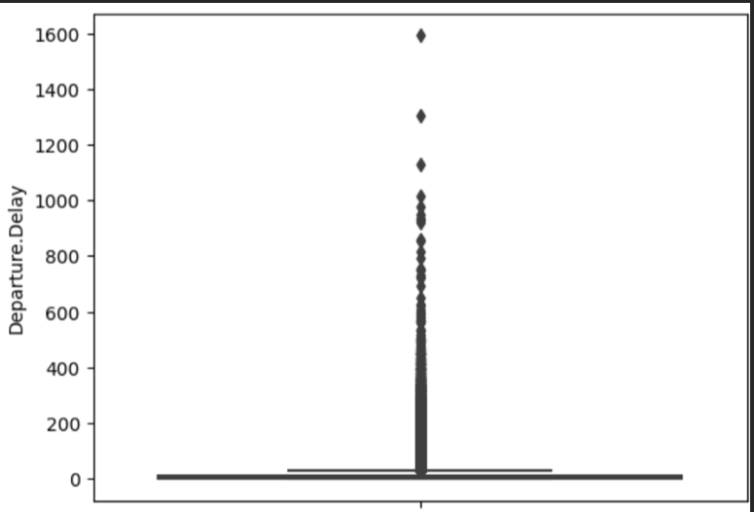
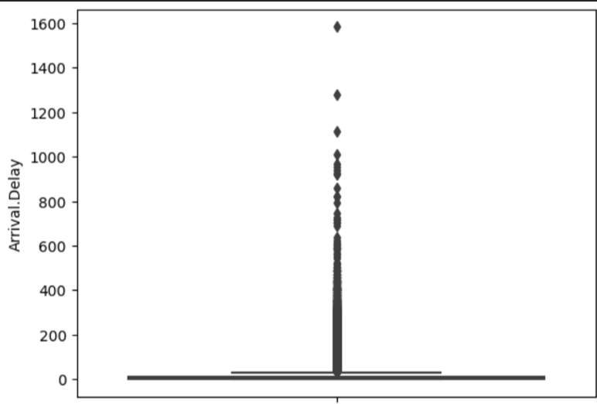
DATA QUALITY ASSESSMENT (PART 2)
Identifying outliers

Slide 16
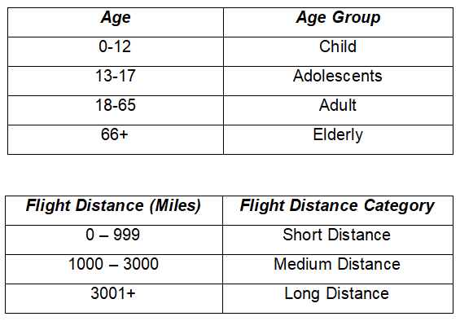
DATA QUALITY ASSESSMENT (PART 3)
Data Binning
Binning data to simplify large amounts of data to make it easier to process and understand

Slide 17
04
EXPLORATORY DATA ANALYSIS
Distribution, Correlation & Feature Importance

Slide 18
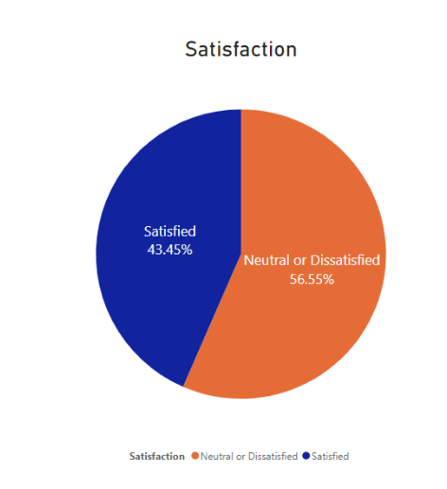
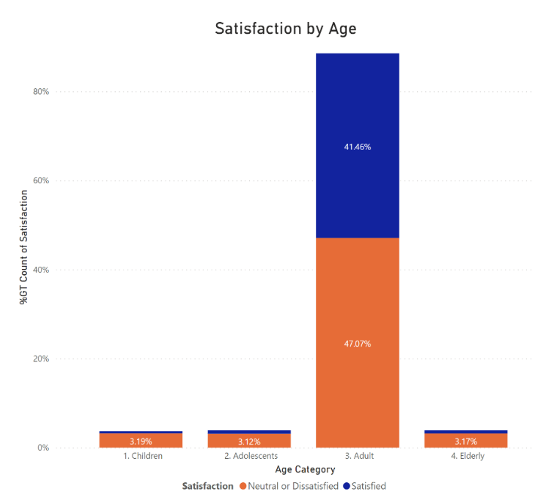

DISTRIBUTION: DEMOGRAPHIC
Generally, less than half of the customers surveyed are satisfied with the services
Even across different age group, most customer are prone towards neutral and negative view

Slide 19
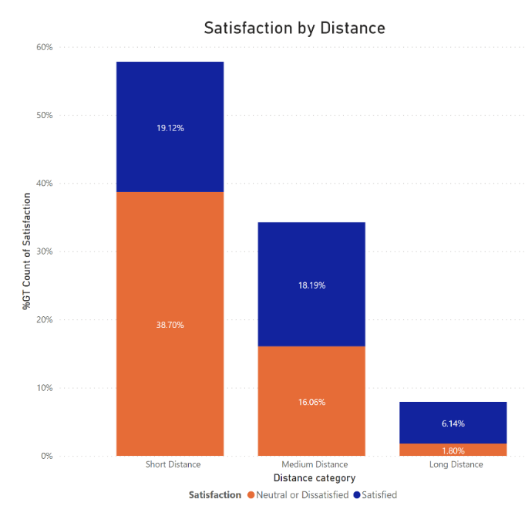
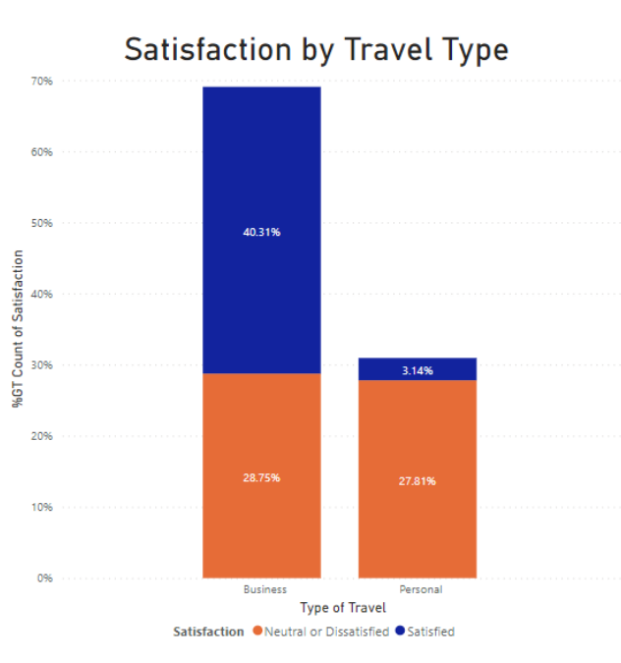
DISTRIBUTION: TRAVEL CATEGORY
However looking at travel type, Business customers are more likely to show their satisfaction of their flight experience
In the context of flight distance, interestingly long haul flights customers are more satisfied as compared to short flights within their same grouping

Slide 20
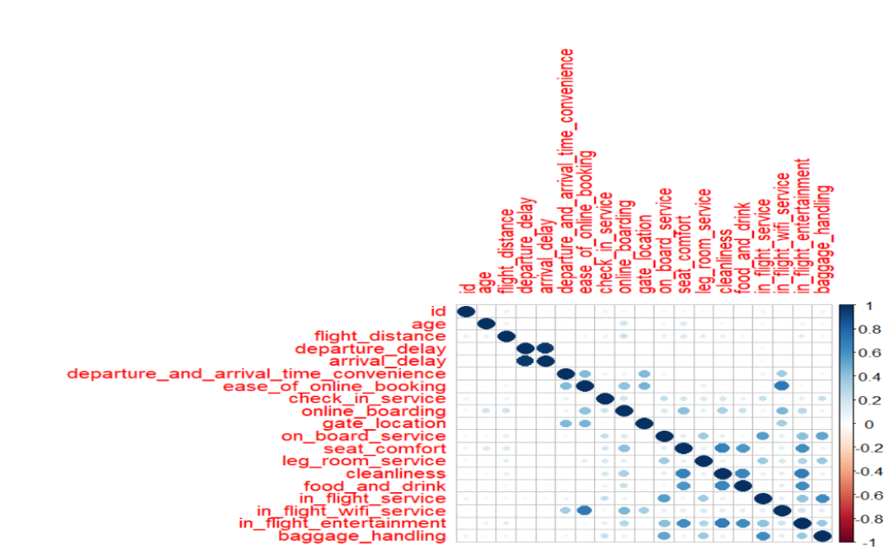
CORRELATION OF FEATURES
For correlation, we focus on numerical features
There are no negative correlations among the features
There is some features which shows high correlation pairs such as
in-flight WIFI service with ease of online booking
cleanliness and in flight entertainment
Possibly need to test for multicollinearity before can be use as features in modelling

Slide 21
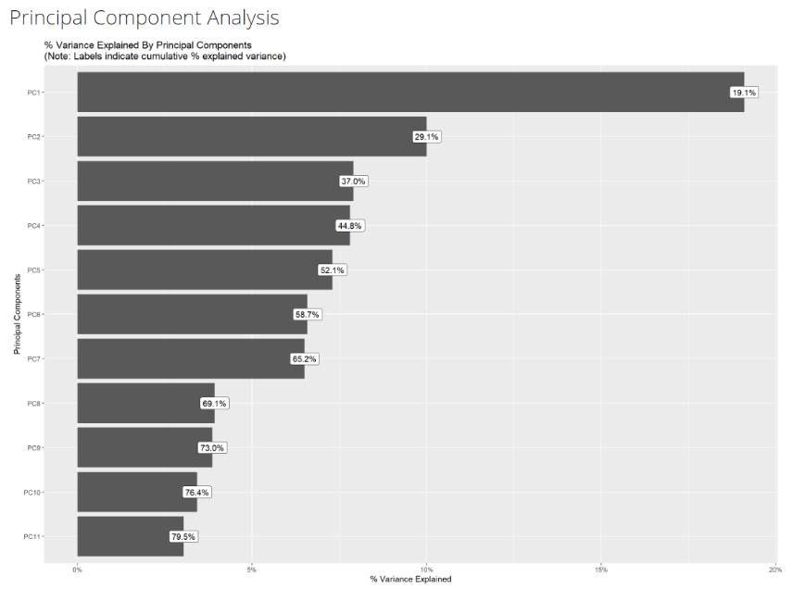
FEATURES IMPORTANCE
To understand the features relationship to satisfaction of customers of their flight experience, we use the Principal Component Analysis as indicators
PCA identified that the features can be grouped together into 11 principal components
From these 11 principal components, the aggregate explained variance is around 80%, which is acceptable
Too perfect explained variance will incorporated too much noise and cause overfitting

Slide 22
05
CONCLUSION
Decoding Passenger Satisfaction

Slide 23

BULLET POINTS
Recap: Competitive nature of the aviation industry and the critical role of passenger satisfaction.
Key Findings: Varied satisfaction levels across customer segments, with business travelers and long-haul flights standing out.
Feature Insights: Positive correlations suggest potential areas for improvement and enhanced customer experience.

Slide 24

TURNING INSIGHTS INTO ACTION FOR AIRLINES
Call to Action:
Airlines can use insights derived from EDA to customize their services and improve overall customer satisfaction.
Continuously monitor and adapt to changing passenger preferences for long-lasting benefits.

Slide 25
THANK YOU VERY MUCH!

